Slide 1
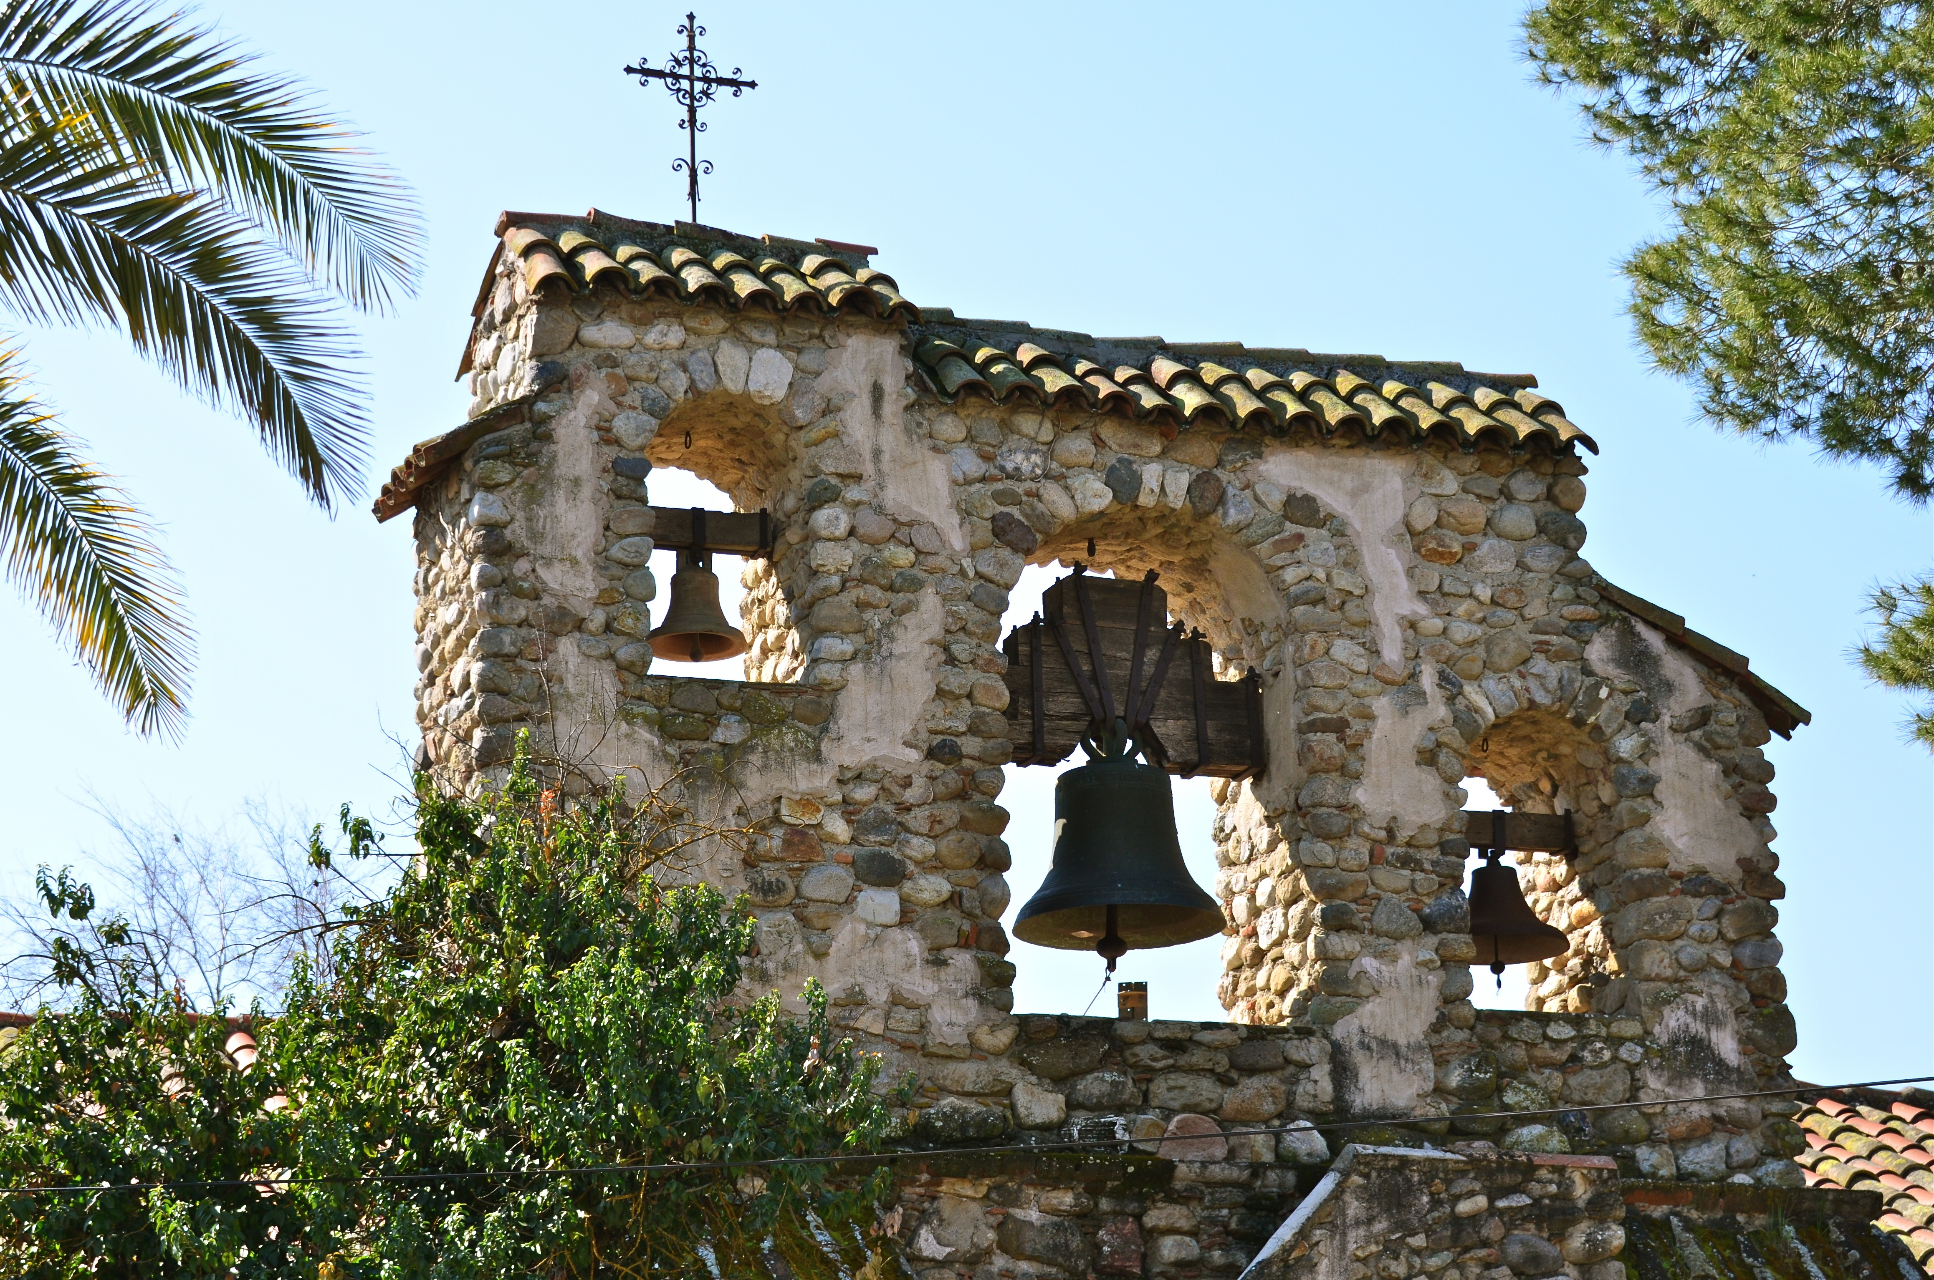


2017-18 Water and Wastewater Rate Study
January 25, 2018

Slide 2

Bartle Wells Associates
Independent utility rate & finance consultants
Professional services: 1) utility rate & fee studies,
2) financial plans, 3) project financing
Charter Member: National Association of
Municipal Advisors
Extensive experience developing long-term financial plans,
rate models, and utility rate and fee studies
Advised over 500 public agencies throughout California
BWA specializes in water & sewer rates & finance

Slide 3
BWA Project Team
Douglas Dove, PE, CIPMA Principal / Project Manager
  President of Bartle Wells with over 26 years of experience
  Expertise in financial planning, utility rates, impact fees, & project financing
  Recent includes the Cities of Brawley, Heber, Chula Vista, Santa Barbara, Glendale, Modesto, Patterson, Riverbank, Hughson, and Davis
  Erik Helgeson, MBA Project Consultant
  Finance consultant with over 7 years of industry experience
  Expertise developing water & sewer financial plans, rates & fees
  Recent work includes the Cities of Willits and Carlsbad, Humboldt Bay Municipal Water District, Modesto Irrigation District, Madera County, Marin Municipal Water District, Sacramento County, and Denver Water

Slide 4
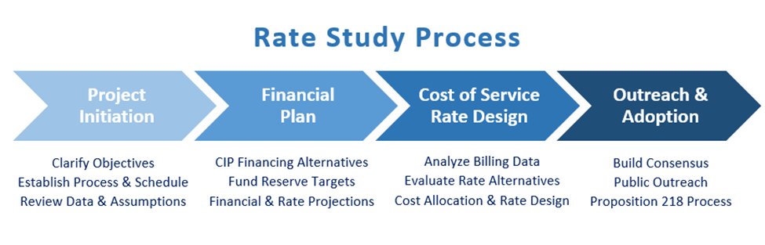
Project Overview
Project began 2017
  Developed draft financial plans
Remaining Work
  Final rate design
  Outreach, adoption, and implementation
Regular input from staff throughout the project has been key to progress

Slide 5
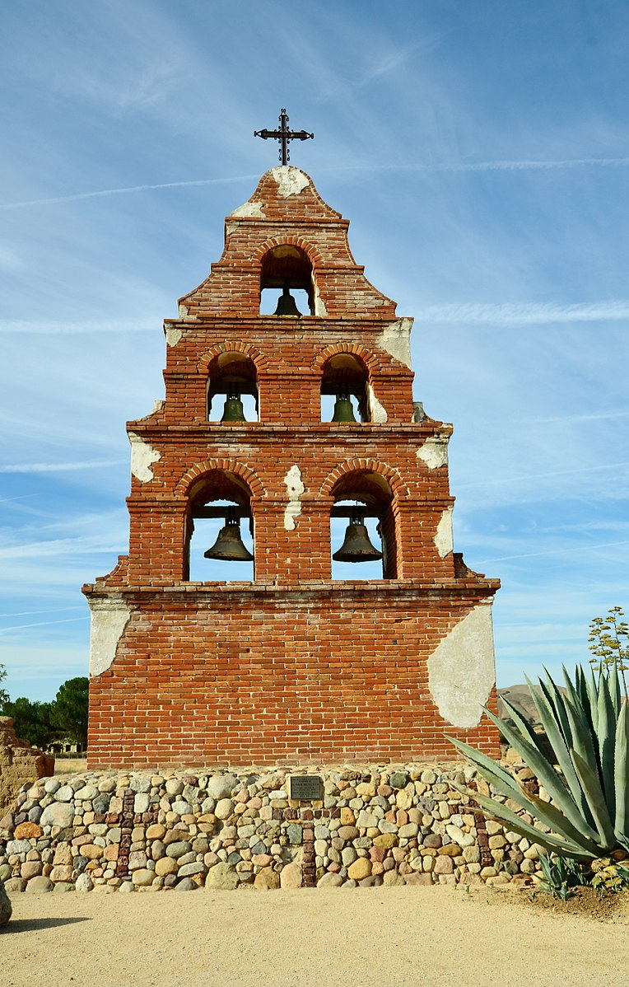
Study Objectives
Financially Sound
  Fund operating and capital costs while maintaining prudent reserves and debt ratios
Legally Compliant
  Prop. 218
Customer Focused
  Smooth, predictable increases

Slide 6

Recommendations
Achieve positive cashflows
Strategically use debt to smooth out the impact of capital spending on rates
Modify rate structures to reflect current customer demand and system characteristics
Prop. 218 states that a customer’s rates
“must not generate revenues in excess of the cost of service for which the fee is charged.” Cal. Const., art. XIII D, § 6, subd. (b).

Slide 7

Water Rate Study

Slide 8
Water Fund Key Issues
Operating fund deficit
  FY 17/18 projected operating deficit $197,871
  To only pay for existing operations (no capital or additional debt service) a 100% rate revenue increase is needed
Projected negative operating reserve (end of FY 17/18)
  Projected $224,020 operating debt to the capital fund
Sizeable Capital Plan
  $12.1 million through FY 24/25

Slide 9
Ten-Year Water Capital Plan
Projected capital spending of $12.1 million (inflation included)
$5.0 million loan in FY 2020-21

Slide 10
Five-Year Water Financial Plan
Projected Rate Revenue Increases

Slide 11
Water Rate Design
Objectives
  Financial sufficiency
  Legal compliance
    Cost of Service (Prop. 218)
Considerations
  Reflect current customer demand
  Capital financing options
  Ease of implementation
  Fairness
  Revenue stability
  Conservation incentive
  Affordability
Developing rates which strike the right balance for the District
Conservation
Revenue stability
Affordability
Equity

Slide 12
Water Rate Structure Recommendations
Residential
Three tiers based on layering supplies
Non-Residential
Two tiers to not prioritize any specific type of commercial use but still reflect to cost of service

Slide 13
Residential Water Customer Bill Impacts
Less than 40% of bills greater than 6 CCF
Bill Increase
$40.54
Less than 75% of bills greater than 12 CCF
Bill Increase
Less than 95% of bills greater than 24 CCF
Bill Increase
$58.84
$124.93

Slide 14
Proposed Monthly Water Rates

Slide 15
Proposed Monthly Water Rates

Slide 16
Monthly Residential Water Rate Survey

Slide 17
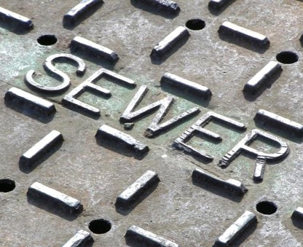
Wastewater Rate Study

Slide 18
Wastewater Fund- Key Issues
Operating fund deficit
  FY 17/18 projected operating deficit $178,491
  To only pay for existing operations (no capital or additional debt service) a 40% rate increase is needed
Projected negative operating reserve (end of FY 17/18)
  Projected $198,872 operating debt to the capital fund
Sizeable Capital Plan
  $12.1 million through FY 22/23

Slide 19
Ten-Year Wastewater Capital Plan
Total Capital Spending $12.1 Million
Projected Debt $8.1 Million (FY 19-20)

Slide 20
Five-Year Wastewater Financial Plan
Projected Rate Revenue Increases

Slide 21
Wastewater Rate Structure Recommendations
Non-Residential
Set single-family charge as a base charge
Keep a specific rate for the school to account for irrigation
Move to volumetric rate based on strength
  Low Strength
  Medium Strength
  High Strength

Slide 22
Proposed Monthly Wastewater Rates

Slide 23
Monthly Residential Sewer Rate Survey

Slide 24
Next Steps
February 22,
2018
Present rates and seek Board permission to issue 218 Notice
April 26,
2018
Public hearing and ordinance adoption
May 1,
2018
Rates implemented

Slide 25
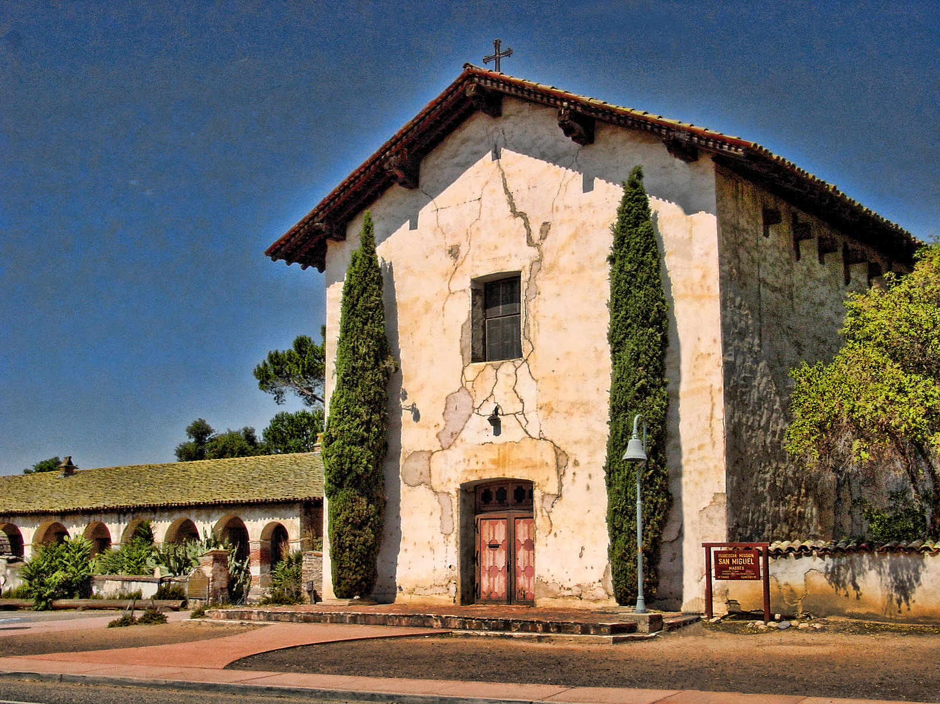
Questions and Comments?

