Slide 1
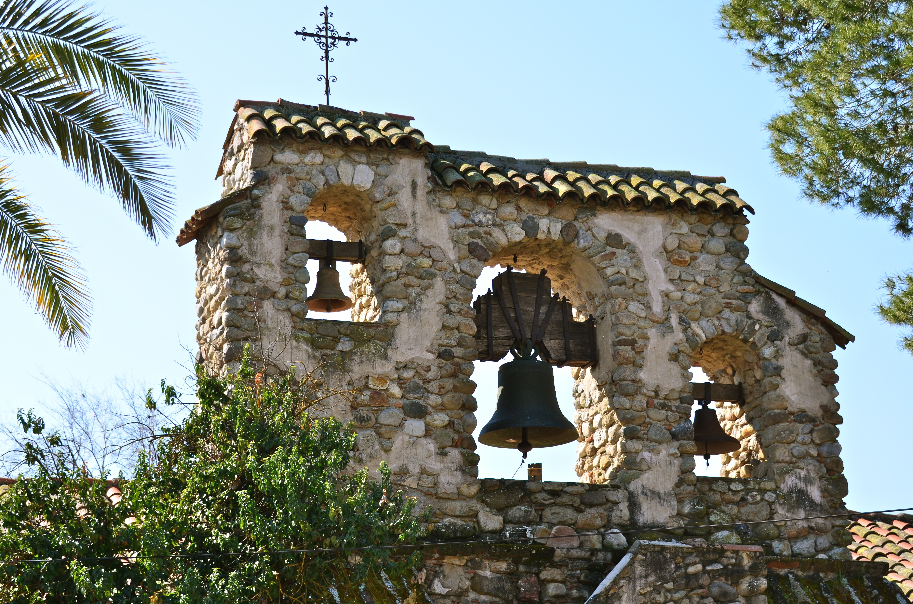


2017-18 Water and Wastewater Rate Study
April 28, 2018

Slide 2

Water Enterprise

Slide 3
Water Fund Key Issues
Operating fund deficit
  FY 18/19 projected operating deficit $336,722
  To only pay for existing operations (no capital or additional debt service), a 100% rate revenue increase is needed
  With no rate increase, the District will have zero funds in
  FY 20-21
Projected reserves end of FY 17/18
  Operating: $0
  Capacity: $445,261
Ten-year capital plan (adjusted for inflation)
  $4.8 million for projects over next 10 years included in this rate increase
  $7 million in additional projects that are not include in this rate increase and if started will require an additional Prop 218 process or tax assessment

Slide 4
Water FY 18-19 Operating Budget

Slide 5
Water Five-Year Financial Plan With No Rate Increase

Slide 6
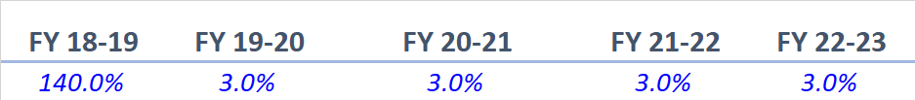
Five-Year Water Financial Plan
Original Projected Rate Revenue Increases

Slide 7
Water Financial Plan comparison
Original Projected Rate Revenue Increases
Revised Rate Revenue Increase
FY 18-19 FY 19-20 FY 20-21 FY 21-22 FY 22-23
105% 10% 6% 6% 5%
For FY 18-19 Up to 1” meter
$40.64 including up to 5 HCF
Residential usage charge
6-12 HCF $3.59 per HCF
>12 HCF $6.12 per HCF
Non residential usage charge
>6 HCF $4.20 per HCF

Slide 8
Ten-Year Water Capital Plan
Capital expenditures included in proposed rates
  $4.8 million (inflation included)
Projects dependent on regulation (excluded from proposed rates)
  Water treatment upgrade: $5.9 million
    Potential capital surcharge $22.70 per month per EDU
      40 years
  SLT pressure system: $1.2 million
    Potential capital surcharge $13.60 per month per EDU
      15 years

Slide 9
Ten-Year Water Capital Plan
Excluded Projects

Slide 10
Water Rate Structure Recommendations
Residential
Three tiers based on layering supplies
Non-Residential
Two tiers which do prioritize any specific type of commercial use and reflect the cost of service

Slide 11
Residential Water Customer Bill Impacts
Less than 40% of bills greater than 6 CCF
Bill Increase
$34.97
Less than 75% of bills greater than 12 CCF
Bill Increase
Less than 95% of bills greater than 24 CCF
Bill Increase
$48.11
$104.84

Slide 12
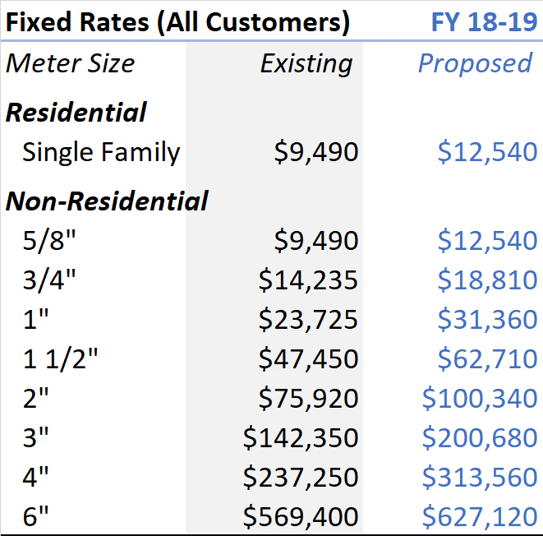
Proposed Water Impact Fees
Recommendation: Multi-Family as Non-Residential

Slide 13
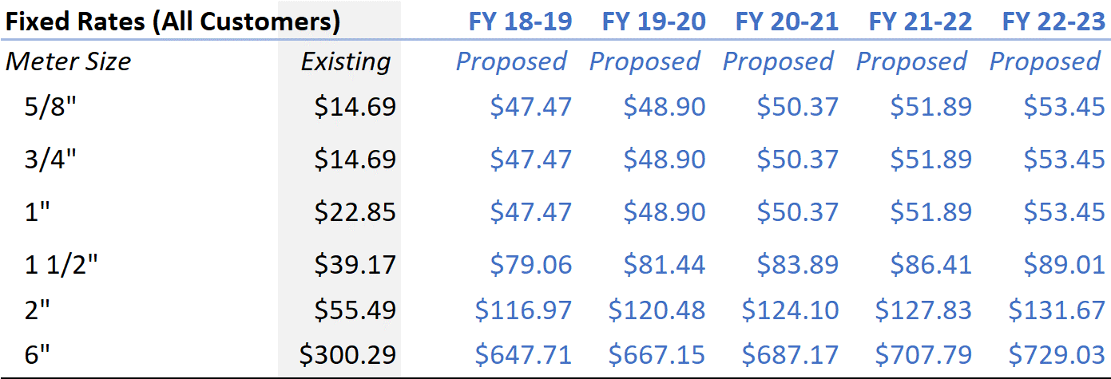
Original Proposed Monthly Rates

Slide 14
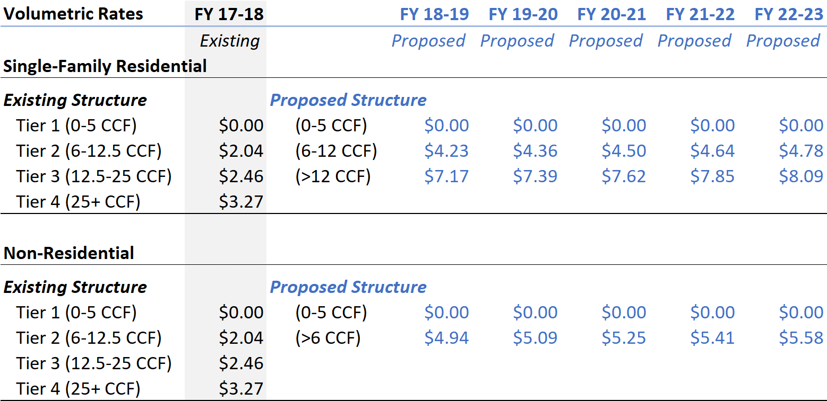
Original Proposed Monthly Rates

Slide 15
Monthly Residential Water Rate Survey
The Revised rate for Residential Single Family at 10 ccf is $58.60. This puts the District between Paso and Templeton

Slide 16
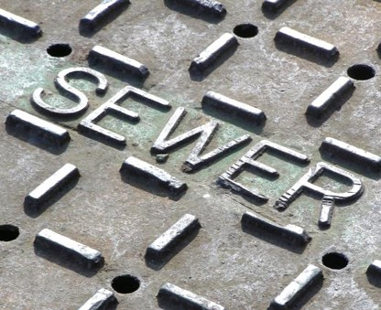
Wastewater Enterprise

Slide 17
Wastewater Fund- Key Issues
Operating fund deficit
  FY 17/18 projected operating deficit $177,221
  To only pay for existing operations (no capital or additional debt service), a 50% rate increase is needed
  With no rate increase, the District will have zero funds in
  FY 21-22
Projected reserves end of FY 17/18
  Operating: $0
  Capacity: $372,194
Ten-Year Capital Plan (Adjusted for Inflation)
  $12.7 million

Slide 18
Wastewater FY 18-19 Operating Budget

Slide 19
Wastewater Five-Year Financial Plan With No Rate Increase

Slide 20

Five-Year Wastewater Financial Plan
Original Projected Rate Revenue Increases

Slide 21
Wastewater Financial Plan Comparison
Original Projected Rate Revenue Increases
Revised Rate Revenue Increase
FY 18-19 FY 19-20 FY 20-21 FY 21-22 FY 22-23
90% 25% 10% 5% 4.5%
This rate increase would result in fixed charges for 18-19;
Single Family Multi Family Commercial
$71.81 $44.88 $54.04

Slide 22
Ten-Year Wastewater Capital Plan
Total Capital Spending $12.7 Million

Slide 23
Ten-Year Wastewater Capital Plan
The District is searching for available grant funds to offset these capital projects.
Some projects, like the wastewater treatment plant upgrade and reclaimed water treatment process are being required by state regulation. So regardless of grant funding we have to move forward.
Most projects have been moved back in the timeline from what is shown above in order to lower rates. All the projects listed are important and moving them, although necessary, has a risk associated with it.

Slide 24
Wastewater Rate Structure Recommendations
Non-Residential
Set single-family charge as a base charge
Keep a specific rate for the school to account for irrigation
Move to volumetric rate based on strength
  Low Strength
  Medium Strength
  High Strength

Slide 25
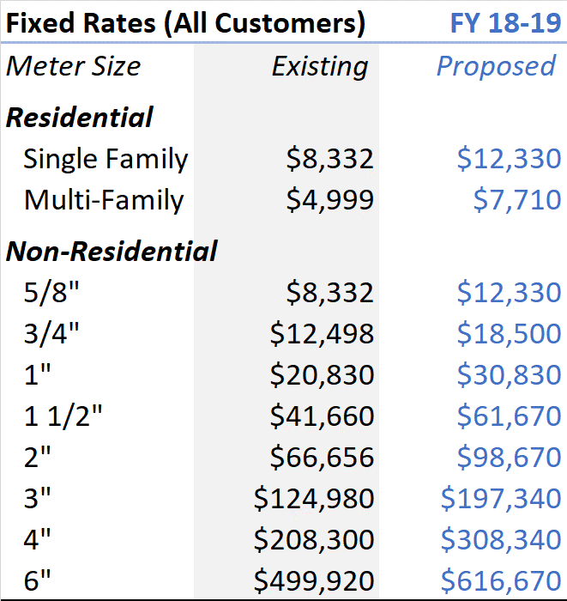
Proposed Wastewater Impact Fees

Slide 26
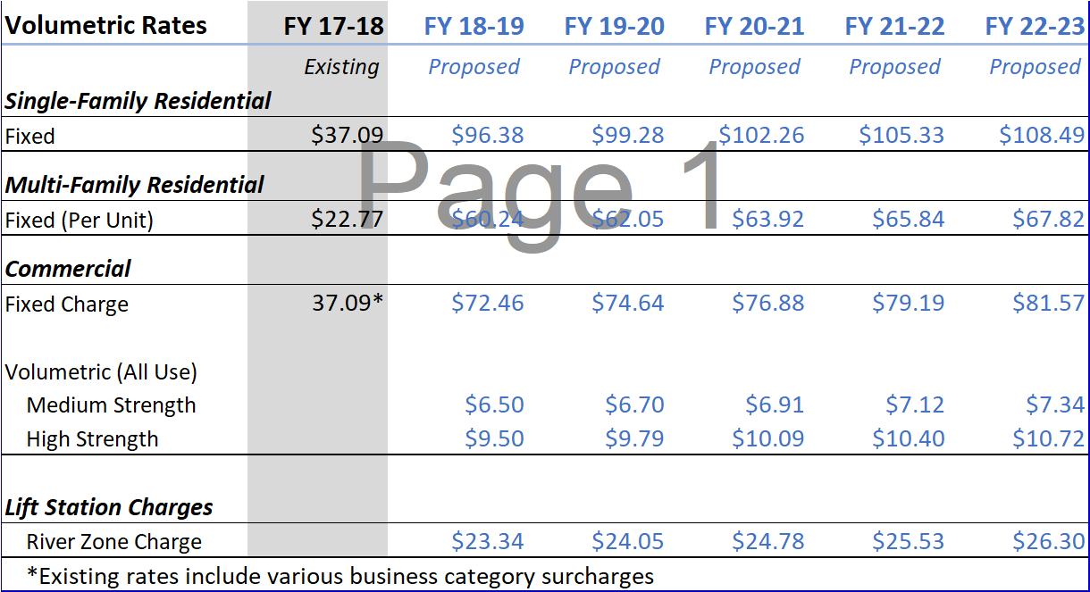
Wastewater Proposed Rates

Slide 27
Monthly Residential Sewer Rate Survey
The Revised rate for Residential Single Family is $71.81. This puts the District between Cambria and Morro Bay (Morro Bay is starting a rate study to raise rates for the construction of their Wastewater treatment plant)

Slide 28
Next Steps
May 24,
2018
Public hearing and ordinance adoption
June 1,
2018
Rates implemented

Slide 29
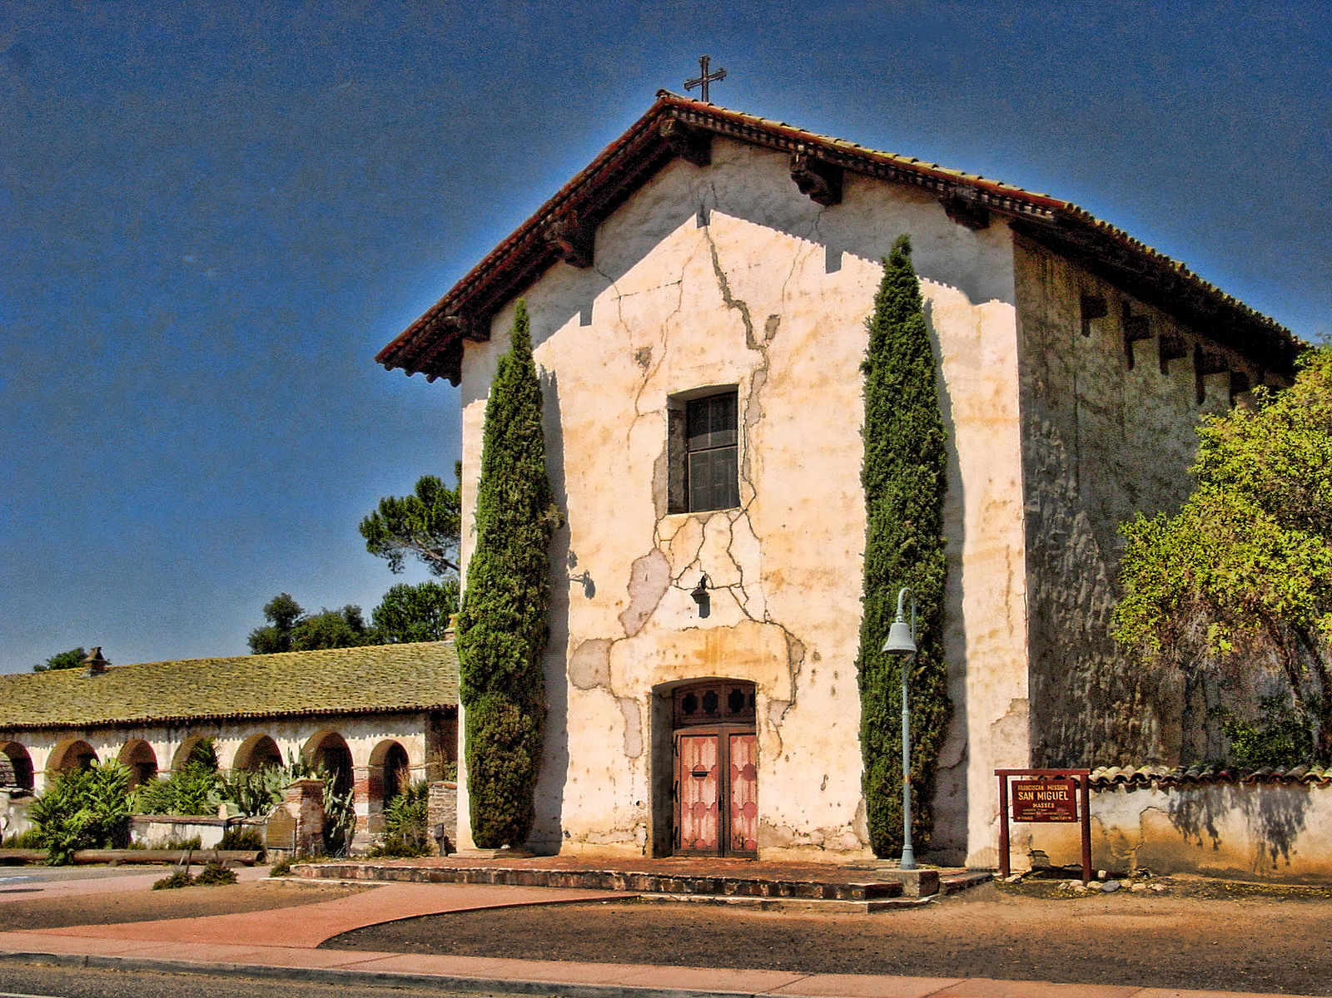
Questions and Comments?

