Slide 1
MACHADO
WASTEWATER TREATMENT FACILITY
UPGRADE
PROJECT STATUS REPORT
AUGUST 26, 2021

Slide 2
PROJECT OVERVIEW
Existing
EXISTING MACHADO WWTF
  Facultative Aerated Treatment Pond System
  Waste Discharge Requirements (WDR) Order No. 99-046
  Treatment Capacity 200,000 GPD
  Originally Constructed in 1985
  Last Major Upgrade in Late 1990’s
  On 6/18/18 the District received a letter from SWRCB outlining the status of the plant and setting a timeline of approximately 2.9 years before the plant reaches capacity.

Slide 3
PROJECT OVERVIEW
Future
FUTURE MACHADO WWTF
  Membrane Bioreactor Treatment System
  Title 22 Recycled Water Production Capacity
  Solar Power Generation Component
  “Purple Pipe” Recycled Water Distribution System (Future)
  Recycled Water Delivery to Local Vineyards (In-Lieu of GW Pumping)
  Waste Discharge Requirements (WDR) Order No. R3-2020-0020
  Treatment Capacity 325,000 GPD (Phase 1) 500,000 GPD (Build-Out)
  Planned Start-up 2022

Slide 4
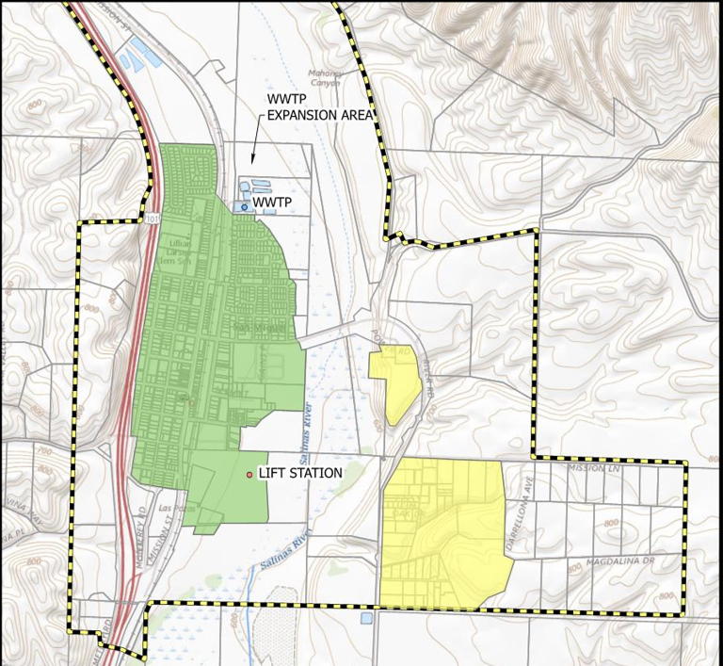

Slide 5
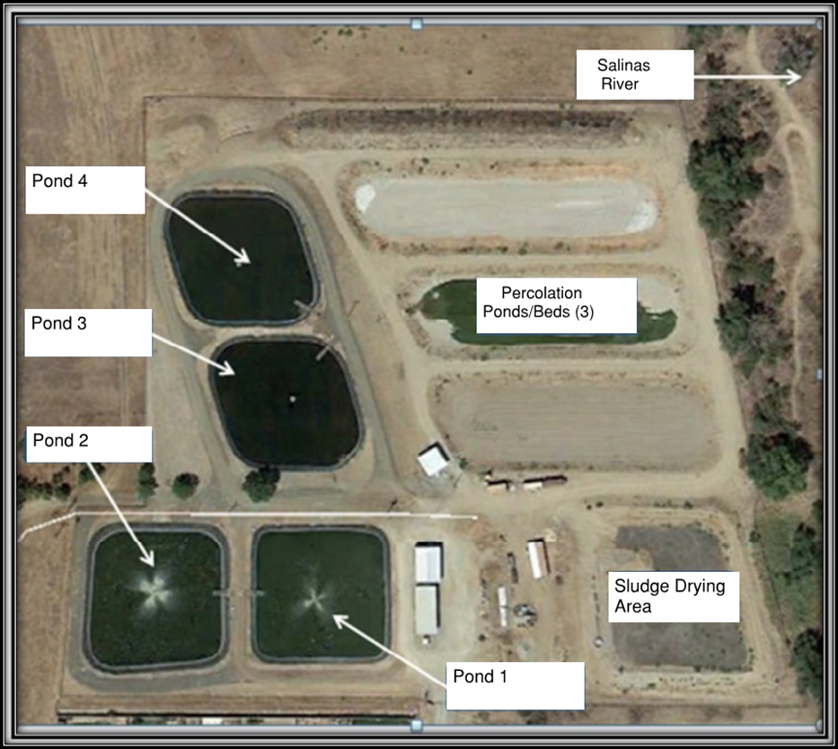
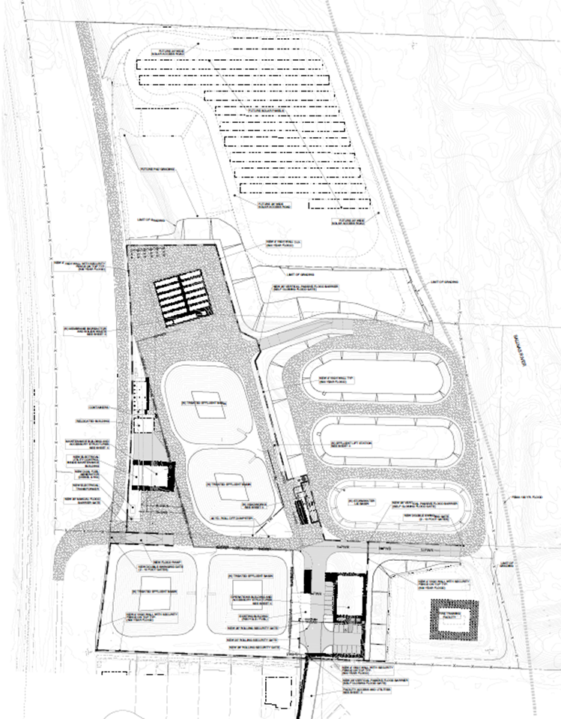

Slide 6
MILESTONES ACCOMPLISHED
June 2018: RWQCB Letter Received Notifying of WWTF Improvements Required
January 2019: WWTF Upgrade Engineering Report Approved
October 2019: WWTF Design Development Agreement to Monsoon Consultants
November 2019: District Receives $250,000 Planning Grant from DWR
April 2020: Preliminary Engineering Report (PER) delivered to USDA
April 2020: WWTF CEQA / NEPA Services Agreement to Dudek
September 2020: RWQCB adopts General WDR (Order No. R3-2020-0020)
June 2021: Bid Received for Pre-Engineered Package MBR Treatment Plant
July 2021: Administrative DRAFT CEQA/NEPA Environmental Document delivered to District.
August 2021: RFB released for WWTF Headworks Screening and Grit Removal Equipment released.

